Slide 1
El Subjuntivo – The Subjunctive
Profe Hodges
Spanish 3
WHS

Slide 2
Moods in Language
A verb TENSE refers to WHEN an action takes place (past, present, future)
A MOOD reflects how the speaker feels about the action.

Slide 3
Moods in Language
There are a few types of “Moods” in language.
You have already learned 2 of the moods in Spanish.
The INDICATIVE mood
Things that were done
Things of certainty
Reality
The IMPERATIVE mood
Commands

Slide 4
Moods in Language
I went to the store.
INDICATIVE
Go to the mall!
IMPERATIVE
Don’t wear that.
IMPERATIVE
She said it.
INDICATIVE
I want the job!
INDICATIVE
Do what you want.
IMPERATIVE

Slide 5
The Subjunctive Mood
There is 3rd mood called the “Subjunctive”Mood.
The subjunctive mood is used to
*Express doubt
*Express desires
*Express uncertainty
*Express things that aren’t real/haven’t happened
The subjunctive is NEVER by itself – it MUST be used after something else.

Slide 6
The Subjunctive Mood
It’s important that you study.
Indicative
(Main Clause)
Subjunctive
(Subordinate clause)
Connects the 2 phrases

Slide 7
The Subjunctive Mood
Recomiendo que tú vayas a la fiesta.
Indicativo
(Cláusula Principal)
Subjunctivo
(Cláusula Subordinada)
Conexión

Slide 8
How to form the subjunctive:
You may have noticed that the subjunctive is like the commands that you have already learned.
“Go to Yo, drop the “o”, add opuesto…there you go!”
FOR –AR VERBS –
Follow the step above and add…
FOR –ER/-IR VERBS –
Follow the step above and add…
E | EMOS
ES | ÉIS
E | EN
A | AMOS
AS | ÁIS
A | AN

Slide 9
Practice
Es necesario que ella ______________ (tener) su libro.
Su mamá quiere que tú ______________ (comer) todas las frutas.
Es importante que Uds. ______________ (estudiar) mucho.
Necesito una amiga que ______________ (decir) la verdad.
Espero que nosotros ______________ (sacar) buenas notas.
Mi profesor nescesita que yo ______________ (ir) a la clase.
Es horrible que Maria no ______________ (obedecer) a su madre.
Ella sugiere que ellos ______________ (jugar) en el gimnasio.
tenga
comas
estudien
diga
saquemos
vaya
obedezca
jueguen

Slide 10
CONJUGATE
SALIR
LLEGAR
SALGA
SALGAMOS
LLEGUE
LLEGUEMOS
SALGAS
SALGÁIS
LLEGUES
LLEGUÉIS
SALGA
SALGAN
LLEGUE
LLEGUEN
CRUZAR
TOCAR
CRUCE
CRUCEMOS
TOQUE
TOQUEMOS
CRUCES
CRUCÉIS
TOQUES
TOQUÉIS
CRUCE
CRUCEN
TOQUE
TOQUEN

Slide 11
IRREGULARS
SER
ESTAR
SEA
SEAMOS
ESTÉ
ESTEMOS
SEAS
SEÁIS
ESTÉS
ESTÉIS
SEA
SEAN
ESTÉ
ESTÉN
DAR
SABER
DÉ
DEMOS
SEPA
SEPAMOS
DES
DEIS
SEPAS
SEPÁIS
DÉ
DEN
SEPA
SEPAN

Slide 12
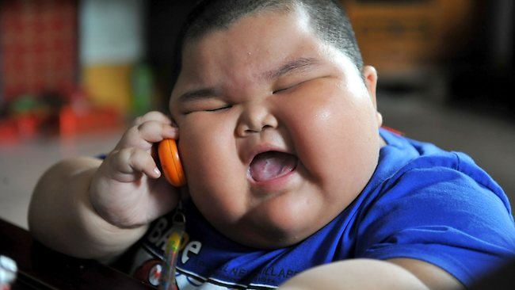
Queridos estudiantes,
Yo soy muy gordo y no hago ejercicio nunca. Necesito ayuda. ¿Qué debo hacer?
-Gustavo Gordo
Use the following Main Clauses and add a subordinate clause using the subjunctive to give Gustavo advice about getting in shape.
-Sugiero que (I suggest that)
-Recomiendo que (I recommend that)
-Es importante que (It’s important that)

